Slide 1


G H PATEL COLLEGE OF ENGINEERING & TECHNOLOGY
(THE CHARUTAR VIDYA MANDAL (CVM) UNIVERSITY)
DEPARTMENT OF COMPUTER ENGINEERING
“AI‑Assisted Dynamic Pricing and Product Content Optimization System for B2C Platforms”
MINI PROJECT (202040601)
Internal Presentation
19th March 2026
Presented By
Internal Guide
Dhruv Patil, Dip Baldha, Harsh Tailor (12302040501012) , (12302040501015 ) , (12302040501019)
Cp, GCET
BRIJESH P. PATEL

Slide 2
Outline
Introduction
Problem Statement
Motivation
Objectives
Literature Review
System Design & Methodology
Machine Learning Model
Tools and Technologies
Implementation
Testing & Results
Conclusion & Future Work
references
12302040501012,15,19
AI‑Assisted Dynamic Pricing and Product Content Optimization System for B2C Platforms

Slide 3
PROBLEM STATEMENT
Problem Statement
In many B2C online systems, pricing decisions and product content management are handled using static methods and manual processes. These approaches do not adequately adapt to changing demand patterns, inventory variations, or customer feedback trends.
As a result:
Pricing decisions may lack data-driven justification.
Product descriptions and review summaries may not effectively support customer understanding.
Decision makers do not receive clear analytical insights to support pricing and content optimization.
There is a need for an AI-assisted decision support system that can analyze available data and provide meaningful recommendations for pricing and product content enhancement.
12302040501012,15,19
AI‑Assisted Dynamic Pricing and Product Content Optimization System for B2C Platforms

Slide 4
MOTIVATION & NEED
Motivation and Need of the Project
Increasing competition in B2C platforms requires better use of data for decision support.
Manual pricing and content updates are time-consuming and inconsistent.
Machine Learning can assist in identifying patterns in demand and sales data.
Generative AI can help summarize customer feedback and generate consistent product descriptions.
The project provides practical exposure to applying AI techniques in real-world business scenarios, aligned with industry practices.
12302040501012,15,19
AI‑Assisted Dynamic Pricing and Product Content Optimization System for B2C Platforms

Slide 5
OBJECTIVES OF THE PROJECT
Project Objectives
To analyze historical sales, demand trends, and inventory data using Machine Learning techniques.
To design a model that recommends an optimized price range for products.
To apply Generative AI for automated product description generation.
To summarize customer reviews into concise and meaningful insights.
To integrate AI components with a Java-based backend architecture.
To demonstrate AI-assisted decision support in a controlled academic environment.
12302040501012,15,19
AI‑Assisted Dynamic Pricing and Product Content Optimization System for B2C Platforms

Slide 6
LITERATURE REVIEW
A research paper on Reinforcement Learning in Dynamic Pricing was studied
It explains:
Pricing as a Markov Decision Process (MDP)
Use of RL (Q-learning, Policy Gradient)
RL learns optimal pricing through interaction
Key Findings:
RL improves revenue compared to traditional models
Handles dynamic market conditions better
Our Approach:
Instead of full RL, we use:
ML demand prediction
Elasticity-based pricing
Visualization + AI insights
12302040501012,15,19
AI‑Assisted Dynamic Pricing and Product Content Optimization System for B2C Platforms

Slide 7
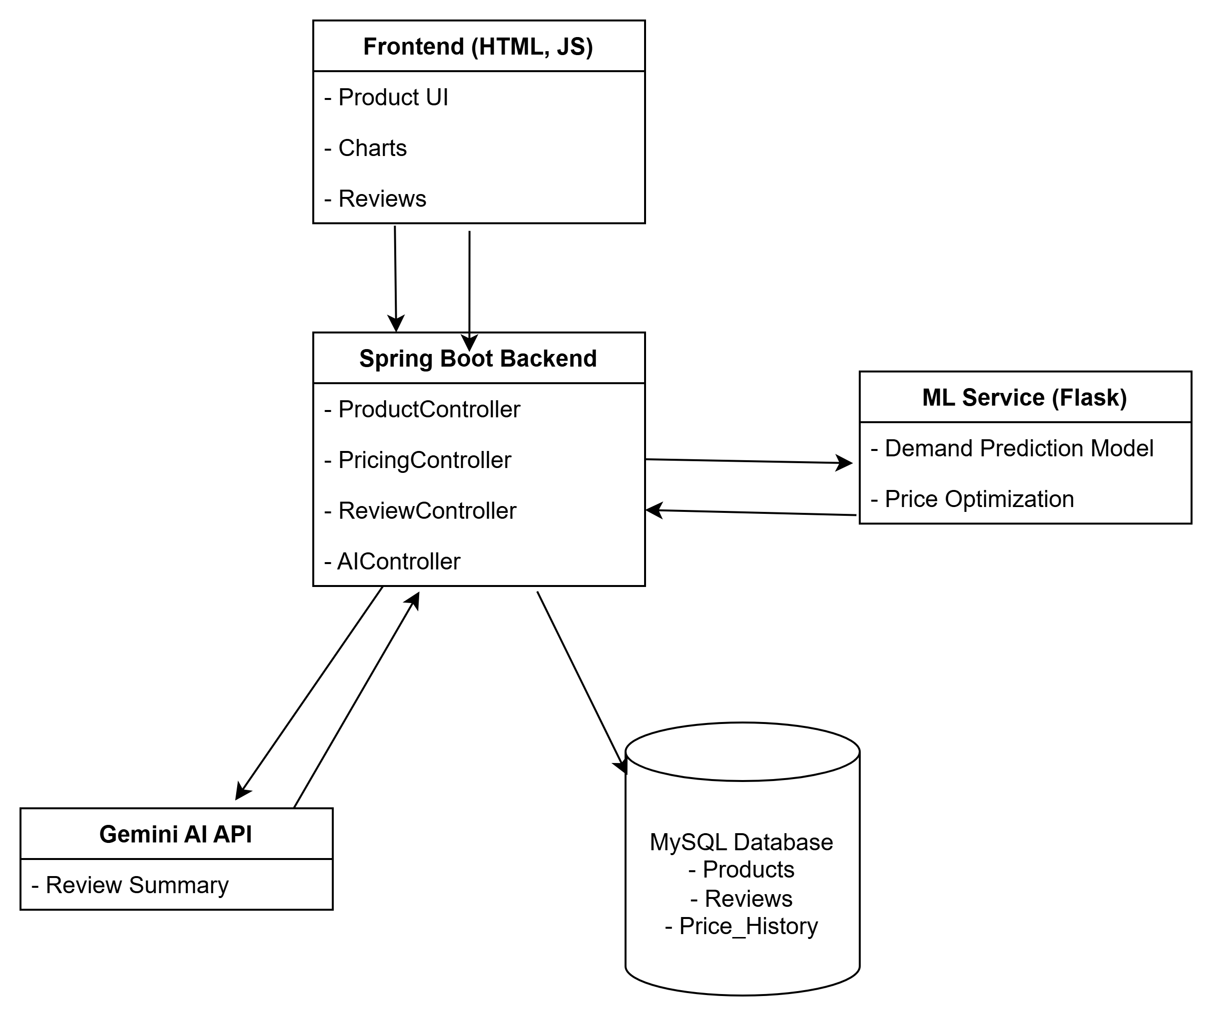



SYSTEM DESIGN AND METHODOLOGY
System Architecture
12302040501012,15,19
AI‑Assisted Dynamic Pricing and Product Content Optimization System for B2C Platforms

Slide 8
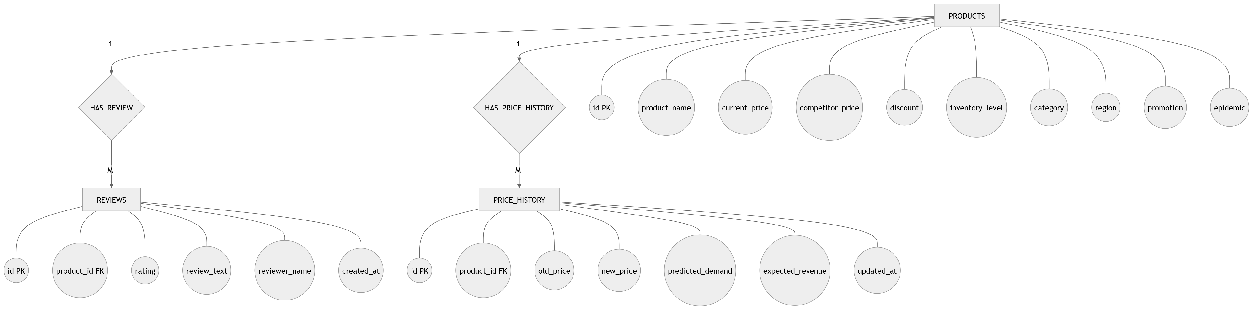
SYSTEM DESIGN AND METHODOLOGY
ER Diagram
12302040501012,15,19
AI‑Assisted Dynamic Pricing and Product Content Optimization System for B2C Platforms

Slide 9
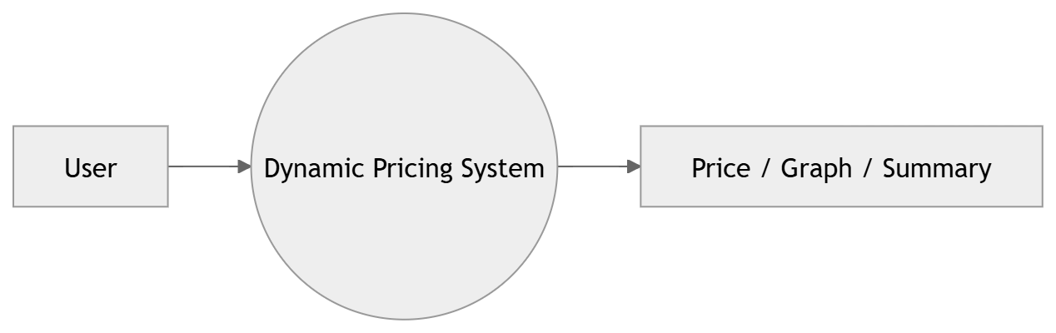
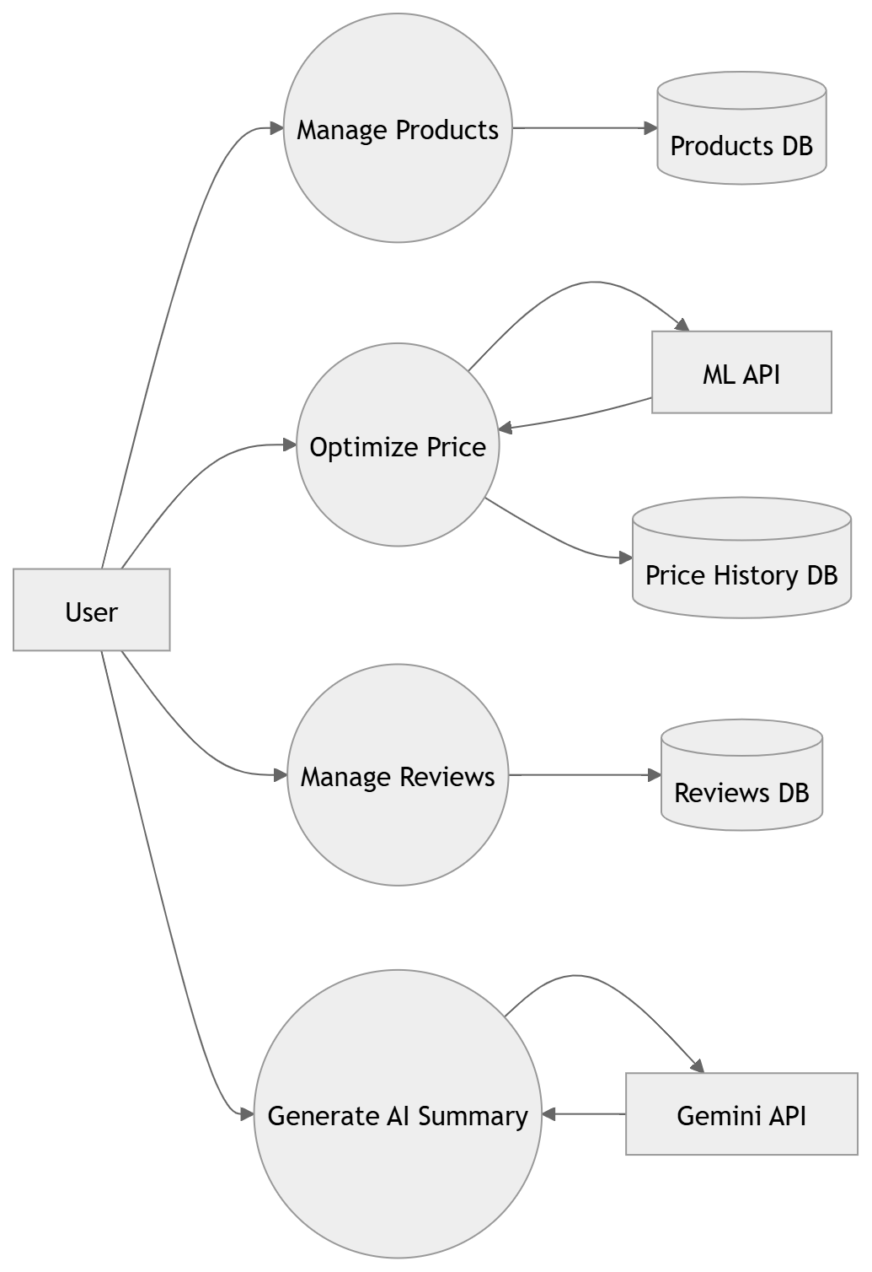
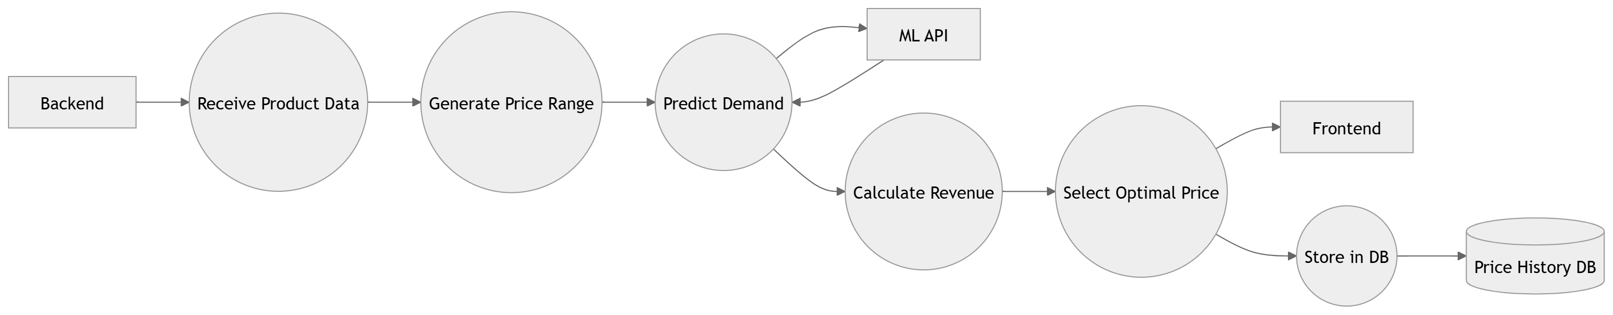
SYSTEM DESIGN AND METHODOLOGY
DFD Level 0
DFD Level 2
DFD Level 1
12302040501012,15,19
AI‑Assisted Dynamic Pricing and Product Content Optimization System for B2C Platforms

Slide 10
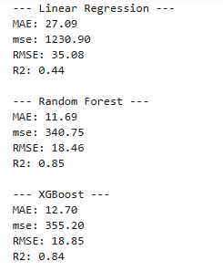
Machine Learning Model
Supervised Learning Model (Regression) Random Forest
Trained using historical product data
Working Process
Input product details
Generate multiple price points (±50% range)
Predict demand for each price
Apply elasticity adjustment
Calculate revenue:
Revenue = Price × Demand
Select price with maximum revenue
12302040501012,15,19
AI‑Assisted Dynamic Pricing and Product Content Optimization System for B2C Platforms

Slide 11
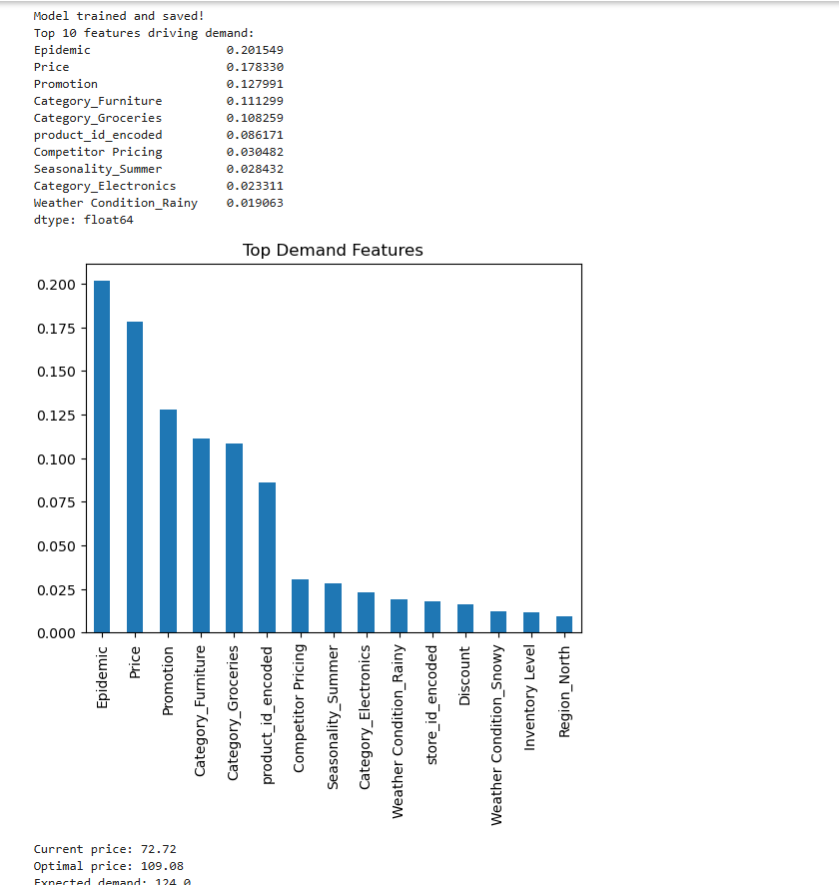
Machine Learning Model
12302040501012,15,19
AI‑Assisted Dynamic Pricing and Product Content Optimization System for B2C Platforms

Slide 12








TOOLS AND TECHNOLOGY
Programming Language: Python, Java | Database: mySQL
Frontend & Dashboard: HTML, CSS, JavaScript | API: Gemini
Backend Framework: Spring Boot & Flask | Version Control: Git & GitHub
12302040501012,15,19
AI‑Assisted Dynamic Pricing and Product Content Optimization System for B2C Platforms

Slide 13
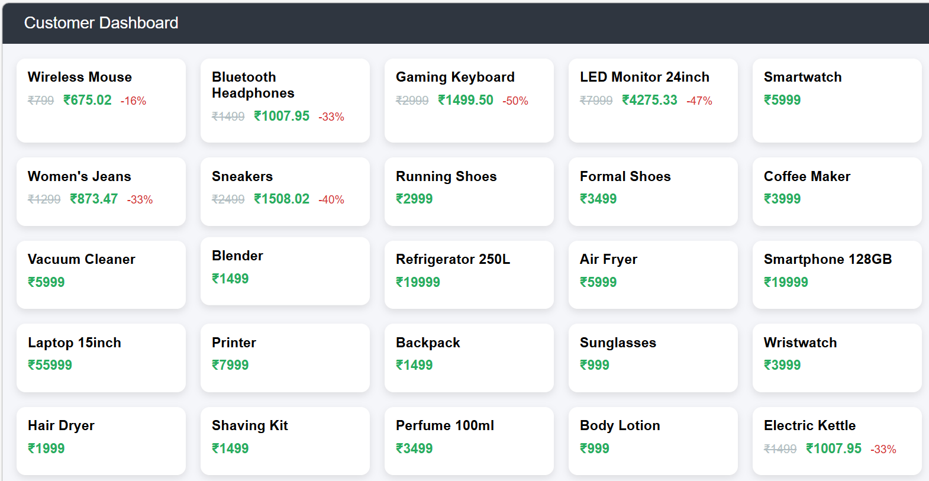
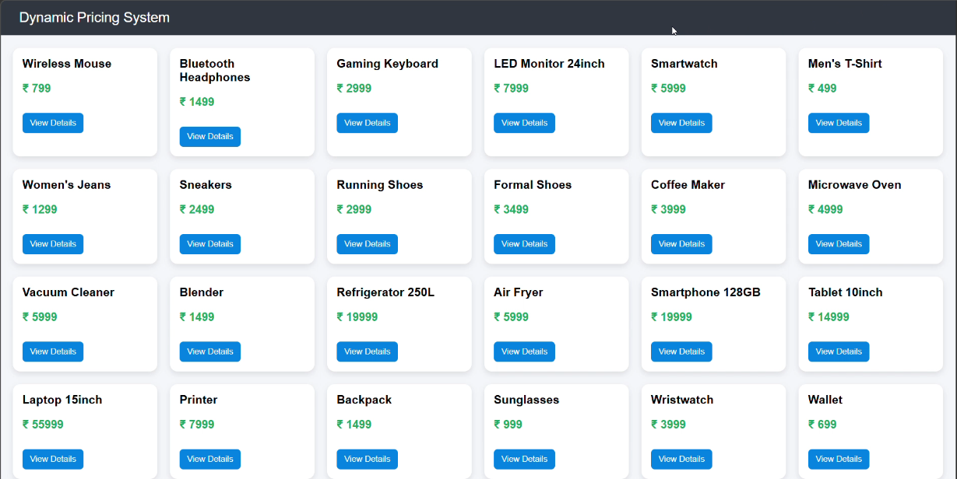
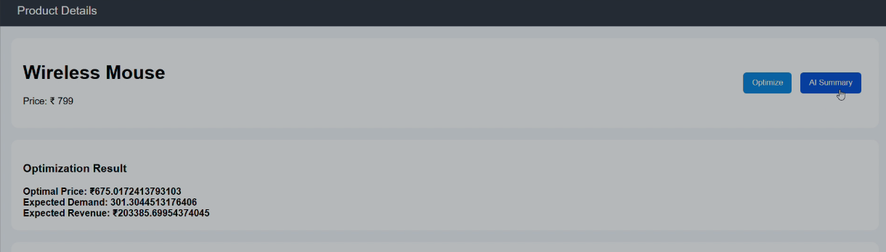
FEATURE IMPLEMENTATION
Features Implemented:
Product listing UI
Product detail page
Optimize button
Revenue graph
Price history graph
AI description
12302040501012,15,19
AI‑Assisted Dynamic Pricing and Product Content Optimization System for B2C Platforms

Slide 14
FEATURE IMPLEMENTATION
12302040501012,15,19
AI‑Assisted Dynamic Pricing and Product Content Optimization System for B2C Platforms

Slide 15
TESTING & RESULTS
Testing:
- Tested different price ranges
- Verified demand prediction
- Checked API responses
Results:
- Revenue curve generated
- Optimal price identified
- Demand decreases with price increase
- System working successfully
Key Metrics:
- Revenue maximization
- Demand prediction accuracy
- Response time
12302040501012,15,19
AI‑Assisted Dynamic Pricing and Product Content Optimization System for B2C Platforms

Slide 16
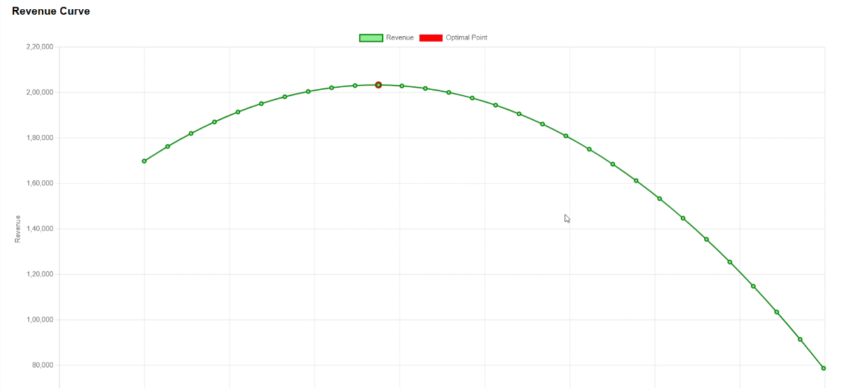
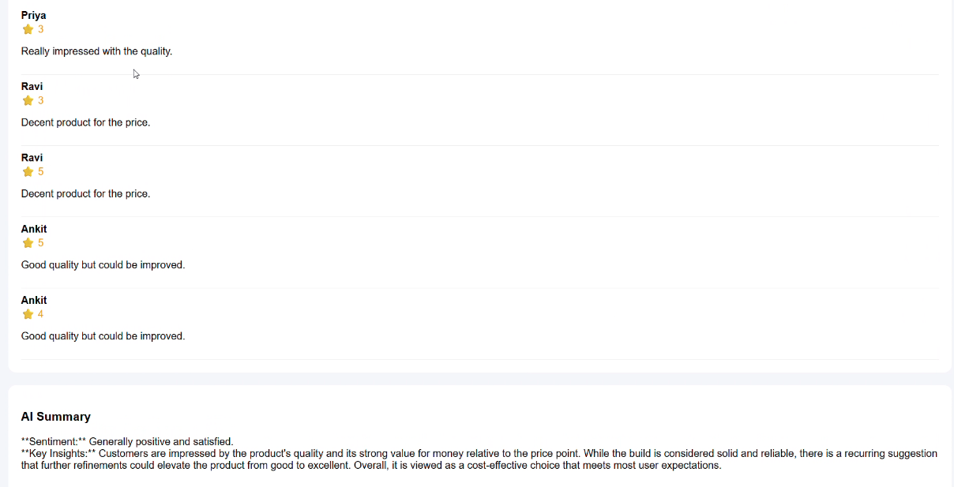
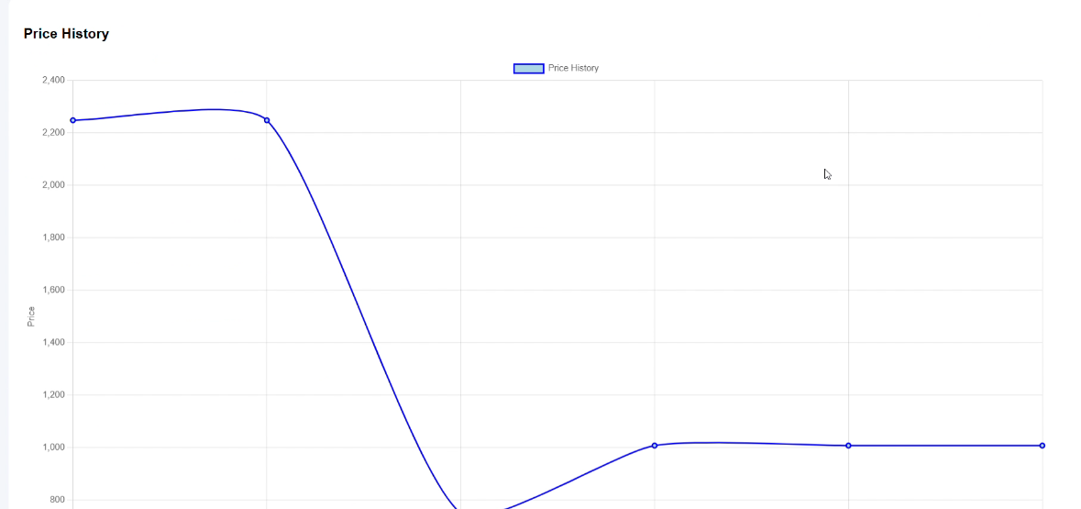
TESTING & RESULTS
12302040501012,15,19
AI‑Assisted Dynamic Pricing and Product Content Optimization System for B2C Platforms

Slide 17
Conclusion & Future Work
Conclusion
The proposed project addresses a real-world problem in B2C platforms using AI techniques.
It focuses on decision support rather than automation, ensuring academic safety.
The project demonstrates practical application of Machine Learning and Generative AI.
Future Work
Integrate live data streams (user traffic, demand spikes)
Automatically update prices without manual trigger
12302040501012,15,19
AI‑Assisted Dynamic Pricing and Product Content Optimization System for B2C Platforms

Slide 18
References
Gil, Andrea. "Using reinforcement learning in Dynamic Pricing Models." Baltic Journal of Multidisciplinary Research 2.4 (2025): 48-69.
http://balticpapers.com/index.php/bjmr/article/view/82
12302040501012,15,19
AI‑Assisted Dynamic Pricing and Product Content Optimization System for B2C Platforms

Slide 19
Thank You…
12020040501012,15,19
AI‑Assisted Dynamic Pricing and Product Content Optimization System for B2C Platforms

